Slide 1
Urban renovation :
Exil for the working-class ? The Parisian experience Alain Lipietz
Seminario International
Gestão inovadora de barrios historicos
Fàbrica de restoro
São Paulo, 10-11 septembre 2018

Slide 2
INTRODUCTION
Birth of Urban melancholy
Le vieux Paris n'est plus (la forme d'une ville Change plus vite, hélas ! que le coeur d'un mortel) ...
(...) Paris change ! mais rien dans ma mélancolie N'a bougé ! palais neufs, échafaudages, blocs, Vieux faubourgs, tout pour moi devient allégorie, Et mes chers souvenirs sont plus lourds que des rocs.
Baudelaire, Le Cygne, 1861
ANTIGA PARIS, MELANCOLIA
The Old Paris is over (the pattern or a city changes faster, halas, than the heart of a mortal. (...) Paris changes. But in my melancholia nothing has changed. New palaces, scaffoldings, blocks, old suburbs, everything turns into allegory for me, and my dear souvenirs are more heavy than rocks.
RELAÇÕES SOCIAIS, SOLIDARIEDADE, SOCIABILIDADE

Slide 3
Aesthetics or social relations ?
Où est-il mon Moulin d’la Plac’ Blanche ? Mon tabac et mon bistro du coin ? (...) Où sont-ils les amis, les copains ? Où sont-ils tous mes vieux bals musette ? Leur javas au son d’l’accordéon ? (...)Mais Montmartre semble disparaître On démolit nos vieilles maisons. Sur les terrains vagues de la butte De grandes banques naîtront bientôt
(Vincent Scotto, sang by Fréhel in Pepe le Moko, Julien Duvivier’s movie, 1937)
Where has gone my wind-mill, Place Blanche, my tobacco shop and my pub round the corner (...) My friends and pals? My old popular dance hall with javas on accordion? Montmartre quarter seams to disappear, they destroy our old houses. On the wastelands of its Hill, big banks will soon be born.

Slide 4
Exile from what ?
Baudelaire 1861 (and Mérimée, Unesco...) : aesthetics, memory of landscape and buildings
Frehel 1937 : solidarity, memory of working-class sociability and fairs
And in Fordist times (1945-1985) ?
And today ?

Slide 5
I. BARON HAUSMANN’S ASSAULT ON PREINDUSTRIAL POPULAR BOROUGHS (XIXe century, 2nd Empire, Paris)
Paris urbanism before Hausmann : Middle-age heritage, vertical social division of space within buildings, yet growth of craft-workers suburbs inside official City and its fortifications (“faubourgs”). RESTAURAÇÃO EDIFÍCIO BURGUESES, MUDANÇA SUBÚRBIOS
Street riots against monarchist restaurations or bourgeois political transitions :
1830 : popular victory in 3 days, but betrayed revolution (from absolute monarchy to constitutional one)
1832 : popular defeat (Les Misérables by Victor Hugo)
1848 : popular “unanimous” victory in February (Social Republic), working-class defeat in June. (The Class Struggles in France 1848–1850 by K. Marx)
1871 : (La Commune) : total defeat in front of French army supported by German Army.

Slide 6
People weapons : barricades in narrow streets of popular quarters
Hausmann’ answer (as Prefect of Paris for Napoleon III, 1853-1870) :
Destruction of old boroughs (bairros),
Large avenues or boulevards
Extension of Paris City to its fortifications (inner suburbs)
Development of “the Zone” (outskirt industrial suburbs, mainly shanty towns) outside the city wall

Slide 7
1832 barricade

Slide 8
Rue du Faubourg du Temple June 1848: 3 barricades

Slide 9
Same spot, today

Slide 10
Jour de pluie in Paris, G. Caillebotte

Slide 11
Boulevard Haussmann, today

Slide 12
2. THE MAKING OF WORKING-CLASS NEIGHBOURHOODS (Third Republic 1871- 1940)
The new Parisian social division of space :
Mainly horizontal (lifts + public transportation systems)
Popular Inner suburbs (“faubourg”)
After WW I : destruction of the fortifications, growing popular outskirt suburbs (“banlieue”)
Beginning “Red Belt” (socialist, communist municipalities) around Paris, absorbing “the Zone”.
The new Parisian building model : the “courée” (housings around an inner yard , with windows towards inside (and community).
The working class villeggiatura : the “guinguettes au bord de la Marne” (the balls on the river Marne)
The Working class dream at the time of Front Populaire : “La Belle équipe” (J. Duvivier, 1936)

Slide 13
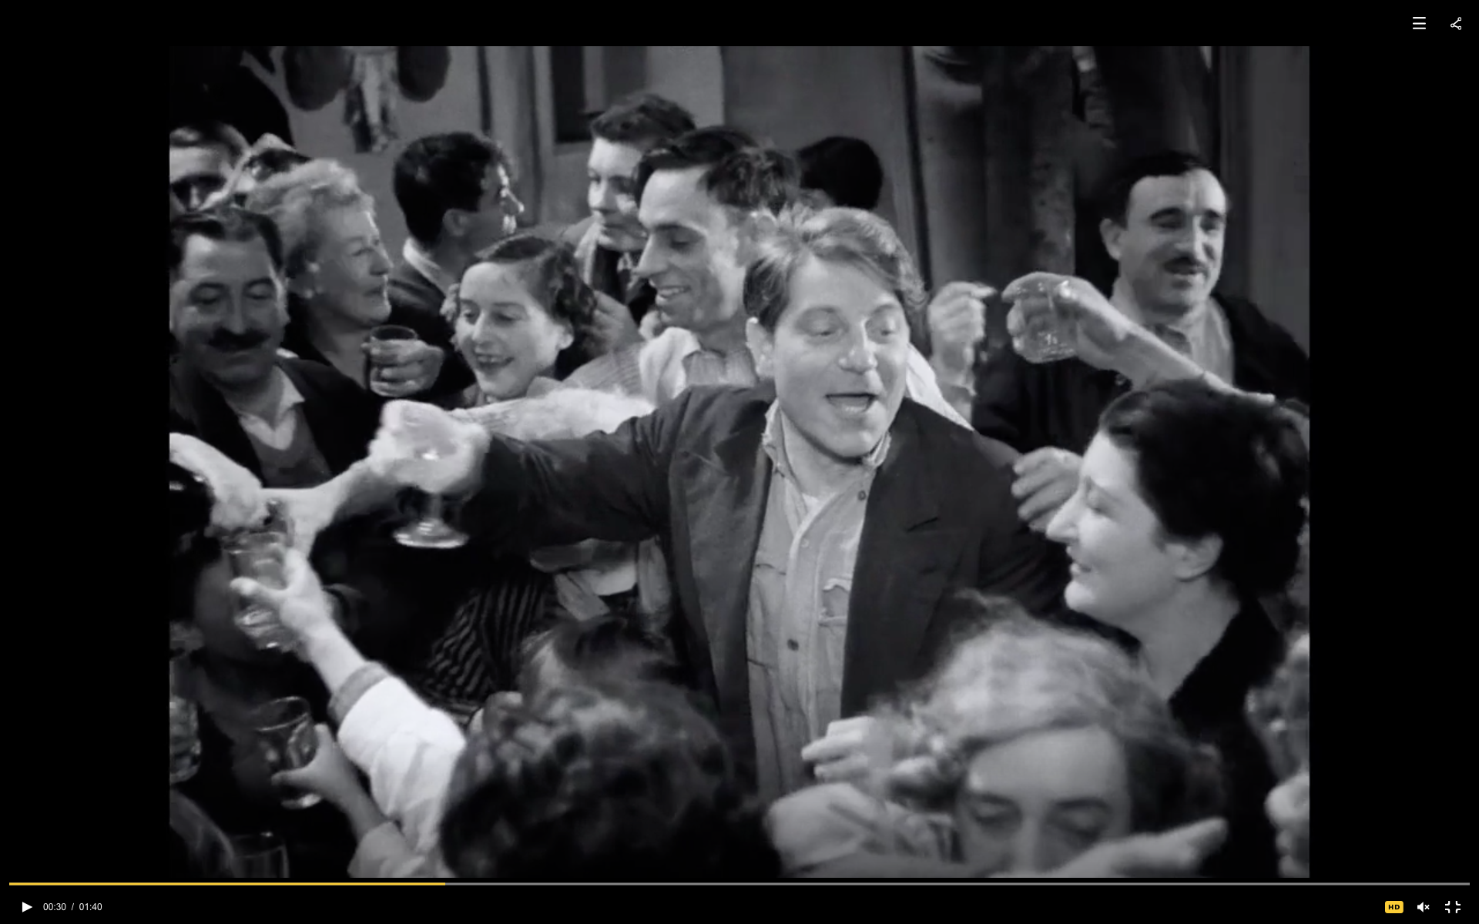
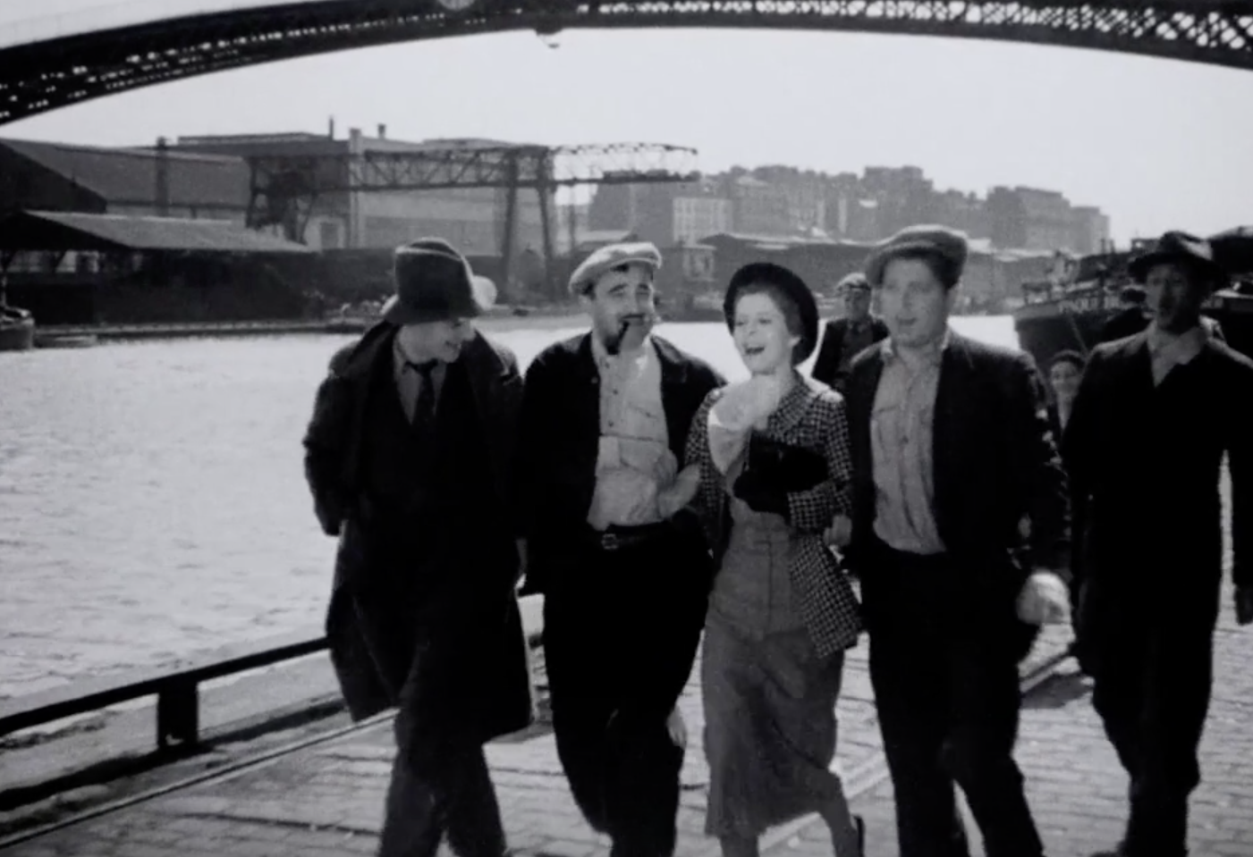
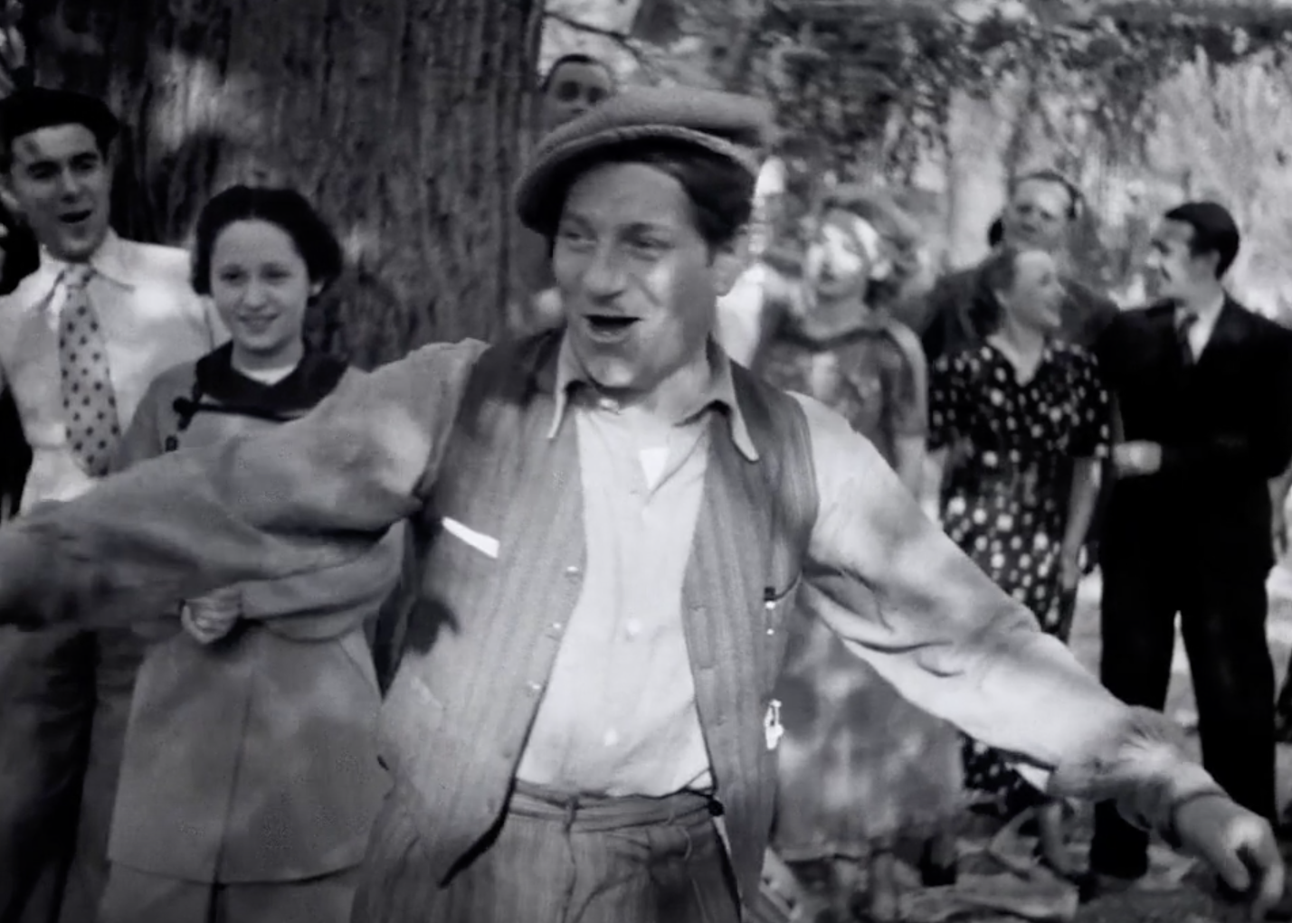
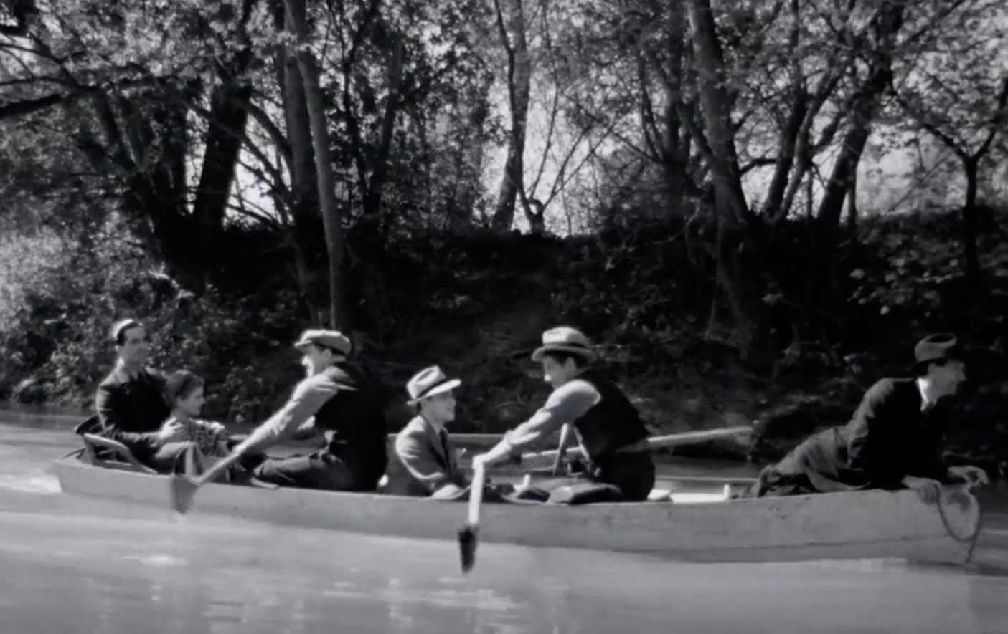
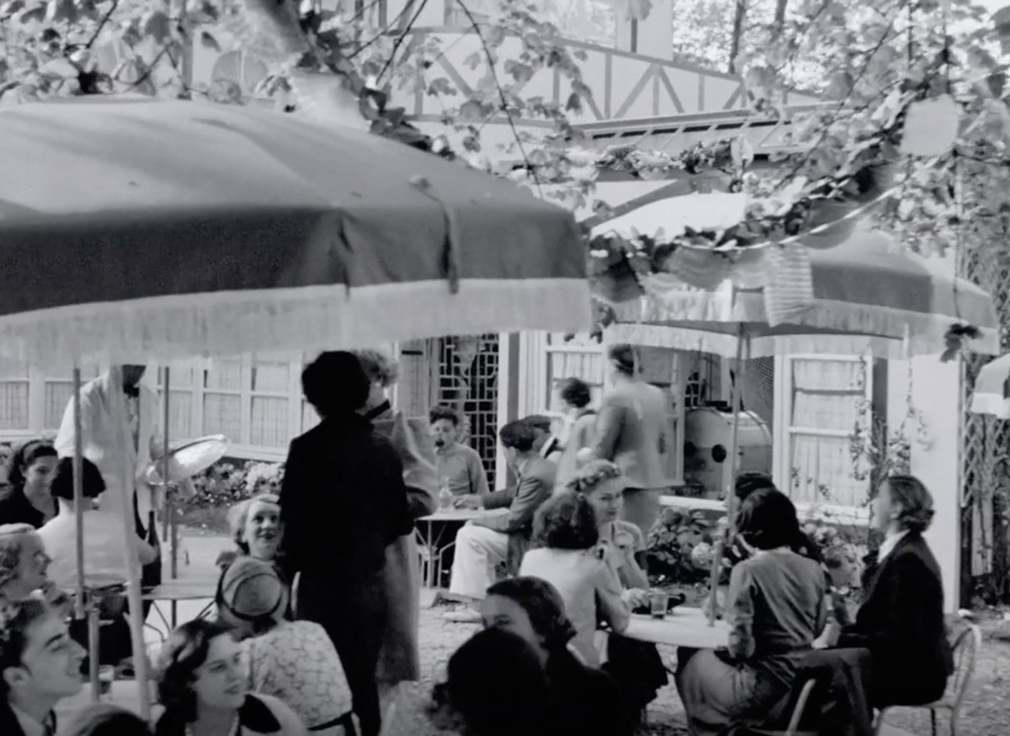
La Belle équipe: A summary of “Front populaire” urban space 1. Mobilization through the windows 2. Fiesta in the yard 3. Walking to countryside along industrial Seine 4. Finding the place... 5. ... By the River Marne 6. Inaugurating the cooperative “guinguette”

Slide 14
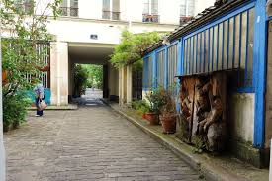
A universal model : « la courée »
Bourgeois courée (today)
Working-class courée
with work-shop
(today)

Slide 15
Misery in Belle Époque: slums on Montmartre inner slope
Notes:
»Le maquis » is on inner side of Montmartre.

Slide 16
Misery in Belle époque: Le quartier National (Paris 13)

Slide 17
Too poor or too much community? The bourgeois reaction
Back to Frehel : the competition for “good places” destroying working class communities
Two social housing policies (in the name of social hygienism) :
Loi Loucheur (1924): subsidizing private self-made houses. The nice side of the Red Belt (the Erik Satie / Robert Doisneau Gentilly)
Low-cost State-subsidized flats : Habitations à Bon Marché (ancestors of Habitation à Loyer Modéré, HLM)

Slide 18
Loucheur houses in near countryside
HBM “Art déco”
on destroyed fortifications

Slide 19
In levelled ex-Zone : The Gentilly of Doisneau HBM + Loucheur House

Slide 20
The Ilot National (and Cité Jeanne d’Arc) case: bourgeois offensive against mobilized communities
Area declared (ineffectively) as unhealthy in 1911 and Januray 1934
Antifascist “riot” 1934, May the 1st
Beginning of the destruction in 1935 under police protection

Slide 21
Place Nationale and rue Clisson 1900

Slide 22
Mobilization Cité Jeanne d’Arc (May the 1st 1934)
After the riot

Slide 23
Place Nationale (and rue Clisson) today

Slide 24
3. THE FORDIST PERIOD (1945-1981)
Concept of Fordism : mass production, mass consumption (American Way of Life)
Plus, in France : intensive rural exodus
Social mobilizations, urban demobilization.

Slide 25
The reconstruction of Quartier National after WW2
Towers with windows on the void (and cars circulation) = inversion of the “courée”. Battle for balconies.
Path-breaking book in urban sociology : “Rénovation urbaine et changement social. L’ilot National” (Henri Coing 1966) :
In Quartier National, housold consumption as a counterpart for housing isolation
Generalization : “La vie quotidienne dans le monde moderne” (Henri Lefebvre 1968) = individual and isolated housing as a constraint to the Fordist consumption model and “colonization of everyday life” (TV, domestic devices + Car + Summer holidays)

Slide 26
Second generation buildings rue Nationale : the balconies (Remember “La Belle équipe...”)

Slide 27
The outburst of ouskirt social housings : La Cité des 4000 (The 4000 Flats City, in La Courneuve, north of Paris)

Slide 28
Popular reactions
No social value for new buildings (“Sarcellite” )
But strong (and generally defeated ) mobilizations for “old” working-class boroughs against “ZAC” A “Zone d’Aménagement concerté” is a Zone of urban development concerted between public administrations and private developers, not with the pre-existing community. Destroys former social relations.
Beginning of gentrification of old popular neighborhoods by “bobos” : “Bourgeois Bohèmes”, trendy lefties, intellectual petty-bourgeoisie.

Slide 29
4. TODAY : THE GREENING of POPULAR HERITAGE (1981-2018)
French “liberal productivist” post-fordism : still productivist, less social
Deepening (more inequalities) and widening (bigger quarters) of social division of space
Colonization of Fordist popular developments by drug traffics
Increasing ethnic segregation

Slide 30
As a result :
Flight from the cities but still polarizations on some megapolis
Increasing fight for “old” (pre-fordist) popular neighborhood, with contradictory effects :
New comers and social mix entail better position for popular inhabitants in : schooling, public services, defense against ZAC.
But progressive and unwanted crowding out of popular classes from popular historical quarters by “bobos”. Different from the crowding out by plain, no-bohemian bourgeoisie, like in the case of Bords de Marne or river Seine.

Slide 31
From rural exodus to city exodus ?
Average annual variation in communes population. Blue : decrease, red : increase; yellow : 0% ->1%, orange : 1->2.5%
(Pierre Pistre)
Notes:
http://www.parisgeo.cnrs.fr/spip.php?article159

Slide 32
Conquest of historical popular quarters in Paris by “Intellectual superior social categories” Beware ! : some through ZAC (12th, 13th), some by extension of “beaux quartiers” (9th) some through gentrification (“Boboland”: 10 th, 20th)
(From Anne Clerval)

Slide 33
Popular Paris turning into museum?
Two actual views of the central spots in:
Le fabuleux destin d‘Amélie Poulain
More than 32 billions views at world box-office, including its frequent references to Auguste Renoir and his Le déjeuner des canotiers
(Restaurant La Fournaise, ile de Chatou, today appropriated by bourgeois NO bohemians).

Slide 34
Against the illnesses of Fordist social housing
The “Renovation urbaine “ by the State (first generation) : destruction of towers + cosmetic transformations of the remaining buildings.
Weak nostalgia from formers inhabitant of Fordist social housing.
Demand for community
New: Demand for “greening”

Slide 35
No “community “ to defend in Fordist HLM
In Villejuif (south of Gentilly) , HLM Lamartine quarter (more than 30 % single mother), 70% want to leave, mainly because of control by narcos on their sons, despite of high level commitment of teachers and mothers in scholar life.

Slide 36
“Greening” of popular heritage (1) By demand for community, and for ecological reasons at local level :
Defense of urban parks (as everywhere : Grenoble, Istanbul... ) and of Loucheur houses
Wave of “shared garden” (mainly for community-building, sometime social economy), both in
historical working-class neighborhood and Fordist HLM developments
Notes:
https://livre.fnac.com/a2204820/Laurence-Baudelet-Jardins-partages

Slide 37
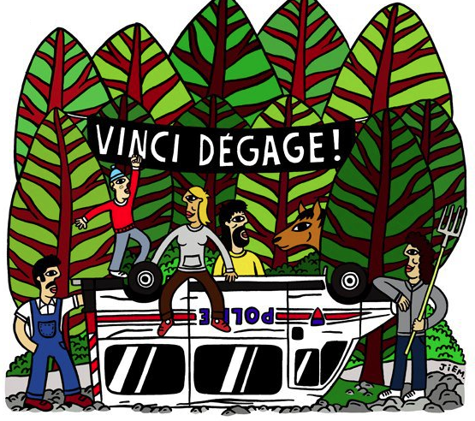
“Greening” of popular heritage (2) Defense of nearby countryside again “GPII ” (useless and imposed major projects)
Hyper-surfaces of commerce (Europacity in “Gonesse triangle” near Montmorency forest, north of Paris)
National stadiums (Plaine de Montjean, south of Paris)
Airports (Notre Dame des Landes near Nantes), motorways...
In these last cases, mobilization is not limited to the (few) local inhabitants. Regional or metropolitan and global concerns (greenhouse effects).

Slide 38
Conclusion Renovate without excluding
Urban renovation sometimes necessary because of “poor” physical heritage or lack of social heritage. But :
Associating REALLY present residents in the process
Creating or saving community spaces
Defending and INCREASING “the green” (gardens , parks, forests, truck farming, both in interstices and periphery of metropolis.)

