Slide 1
Influencing Heritage Policy in the UK
Department of Real Estate & Planning
Henry Russell h.j.g.russell@reading.ac.uk

Slide 2
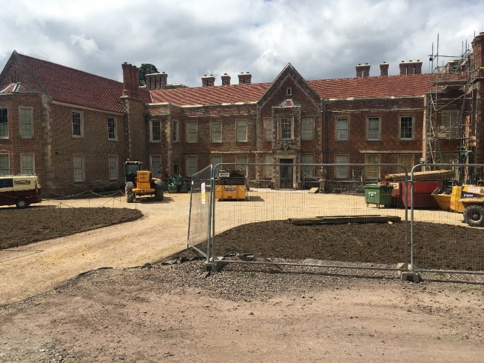
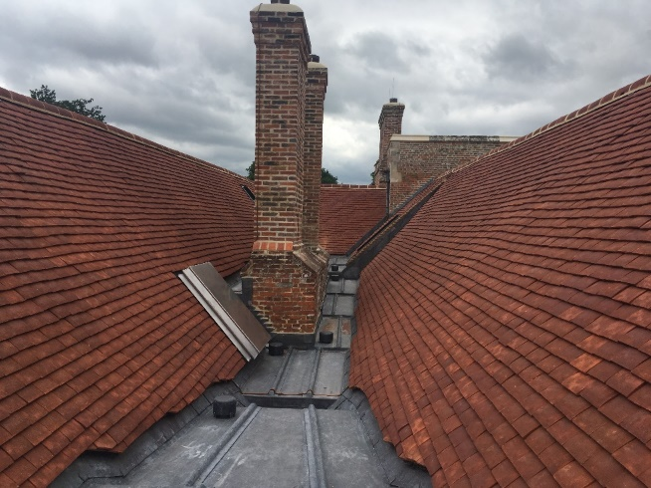
English heritage protection
Heritage is managed through the planning system
Local authorities (LAs) are decision maker
National legislation and policy
Listed buildings
Consent is required for proposals that affect their ‘special interest’
Proposals need to be justified
Like-for-like repair does NOT need consent

Slide 3
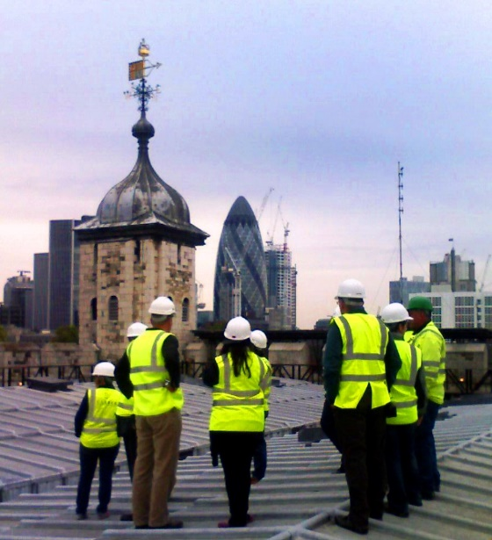
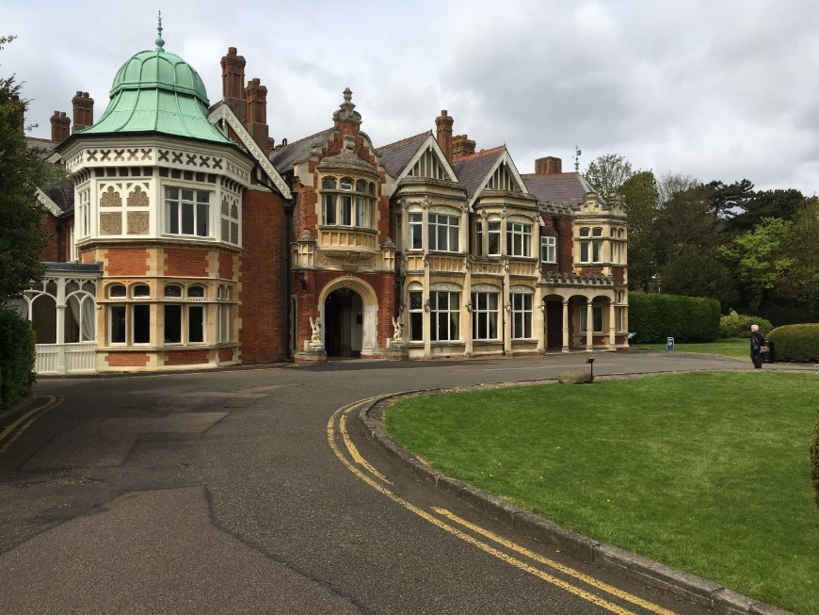
English Heritage Protection
Data for England:
Listed buildings – 377,388
Scheduled monuments – 19.855
Parks and gardens – 1,652
Battlefields – 46
Protected wrecks – 52
World Heritage Sites – 18
Conservation areas – 10,100

Slide 4
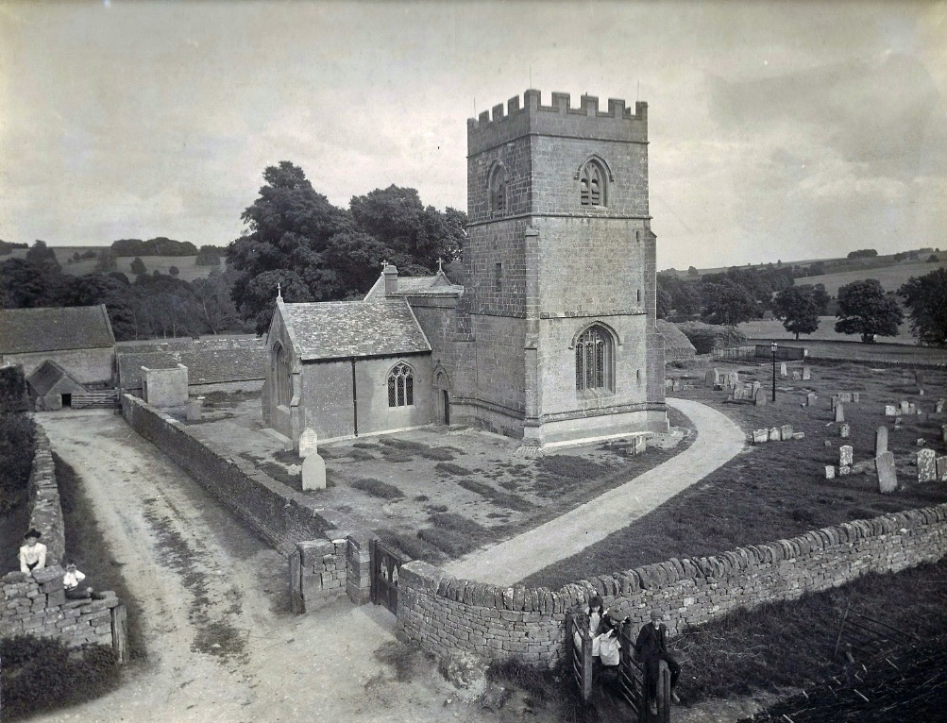
National
Planning and building standards
Heritage
Advises government on heritage matters
Also Treasury, DEFRA (environment), DBEIS (business)

Slide 5
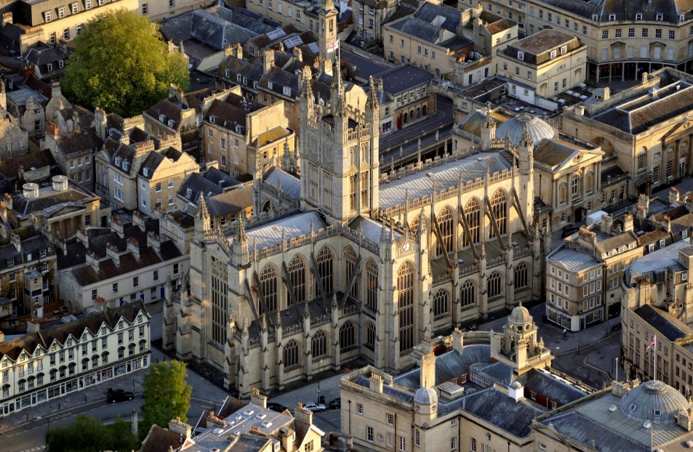
Funding heritage
Heritage Lottery Fund
Historic England
Corporate and charitable donors
Agricultural heritage through government schemes, such as the Rural Development Programme for England (Historic England 2018).

Slide 6
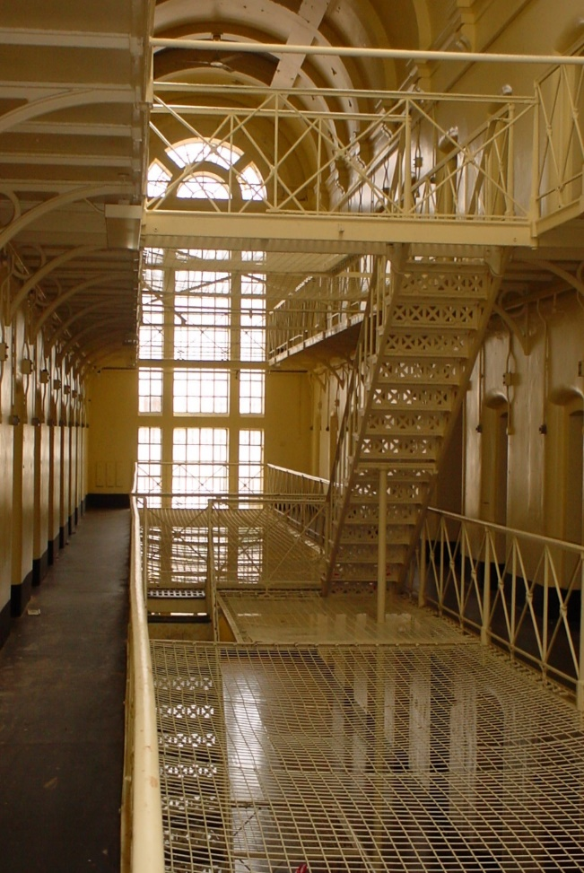
Other policy actors
National Trust
Campaign for the Protection of Rural England
Historic Houses Association
Country Land and Business Association
Amenity Societies
SAVE Britain’s Heritage
Archaeology groups
Professional bodies (architects, engineers, surveyors, etc)
Heritage Alliance

Slide 7
Heritage Alliance
Established in 2002 as Heritage Link
“The Heritage Alliance is England’s biggest coalition of heritage interests. It is a powerful, effective and independent advocate for volunteers and professionals working in the independent heritage sector. It now has over 120 member organisations, ranging from larger charities such as the National Trust and English Heritage to more specialist bodies representing visitors, owners, volunteers, professional practitioners, funders and educationalists.”

Slide 8
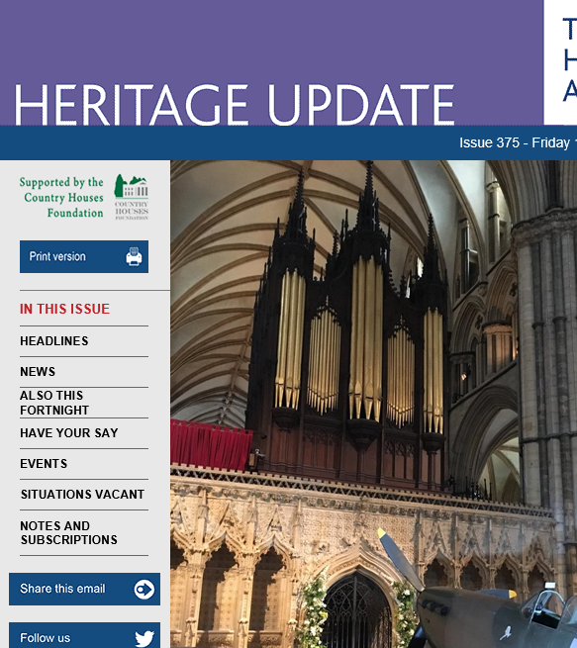
Heritage ALLIANCE ACTIVITIES
Membership of Heritage Council
Secretariat for Historic Environment Forum
Managing ‘Heritage 2020’ (supporting collaboration in the historic environment sector)
Fortnightly ‘Update’ (sponsored)
Heritage Day – speakers include govt minister
Close working with the arts sector and museums
Heritage Funding Directory (jointly with Architectural Heritage Fund)
Historic Religious Buildings Alliance.

Slide 9
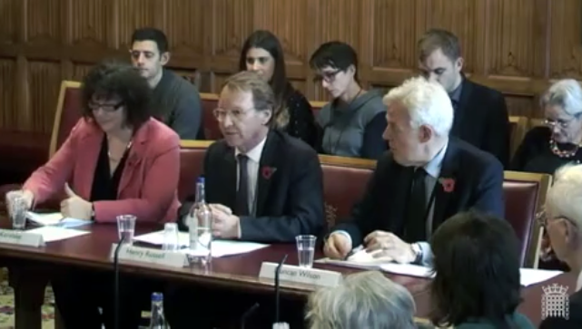
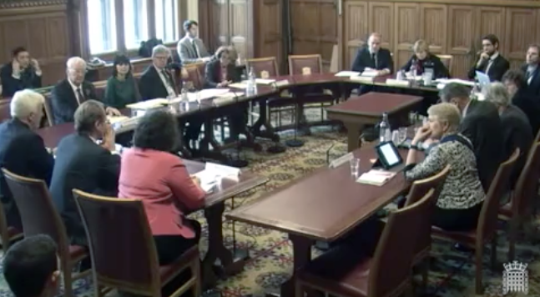
Advocacy groups
Spatial Planning
Respond to consultations
HS2 ministerial round table
Parliamentary committees
Secondary legislation
Rural Heritage
Funding
Inclusion and Learning

Slide 10
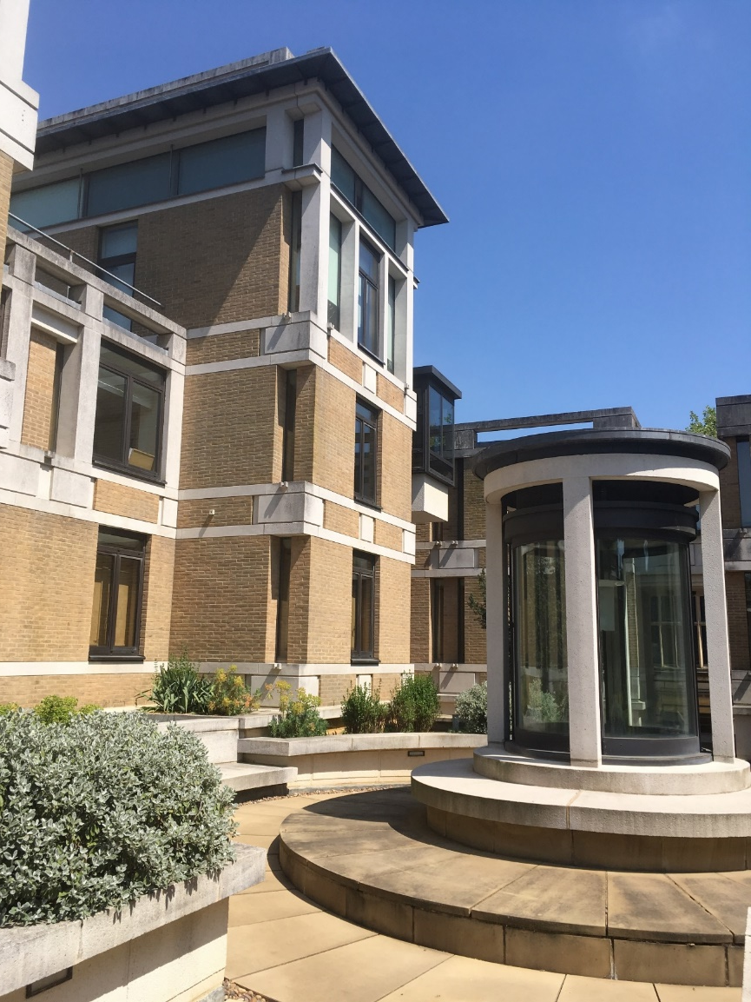
governance
Registered charity
Financed by members subscriptions and grants

Slide 11
How can we help you?
An effective heritage protection system, applied consistently
Heritage policies in strategic plans
Recognition in policy of the value of heritage, cultural, social, economic and environmental
An effective unified advocate/voice for heritage, which
is listened to by policy-makers and law-makers
represents all non-commercial heritage interests
responds to official consultations on law and policy
campaigns for heritage

Slide 12
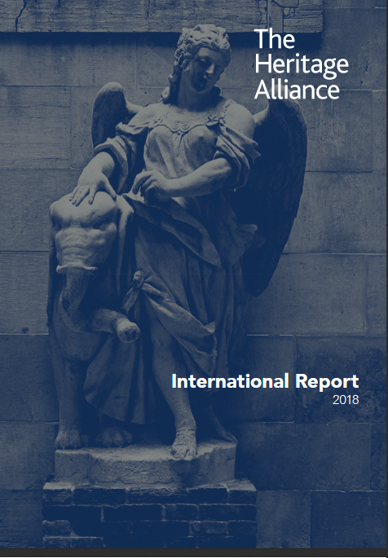
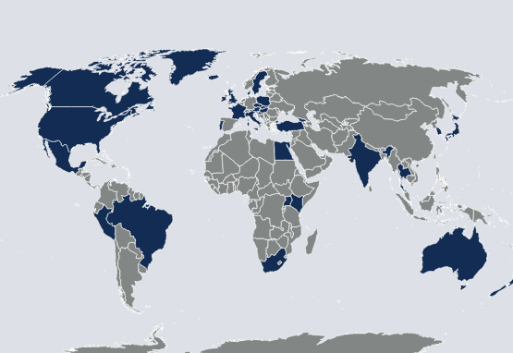
Heritage Alliance International

